Slide 2
Primary Ovarian Insufficiency
Bahia Namavar Jahromi
Department of OB-GYN, Fellowship of Infertility and IVF
17.11.1402( Feb 6, 2024)

Slide 3
Primary ovarian insufficiency (POI)
Definition: development of hypergonadotropic hypogonadism before the age of 40.
Symptoms: similar to menopause( oligomenorrhea or amenorrhea, symptoms of estrogen deficiency, and high FSH)

Slide 4
Pathogenesis and causes of primary ovarian insufficiency
chromosomal defects: Turner syndrome and fragile X syndrome premutation carriers
exposure to radiation and certain drugs
autoimmune disease
Unknown: 75 to 90

Slide 5
DEFINITIONS AND EPIDEMIOLOGY of POI
1 in 250 by age 35 years and 1 in 100 by age 40 years.
Natural menopause: permanent cessation of menstrual periods, determined retrospectively after a woman has experienced 12 months of amenorrhea without any other obvious pathological or physiological cause. It occurs at a median age of 51.4 years in normal women. Menopause is a reflection of complete, or near complete, ovarian follicular depletion, with resulting hypoestrogenemia and high (FSH) concentrations.
"premature menopause" and "premature ovarian failure“: inaccurate because many patients with POI intermittently produce estrogen and ovulate, a few experience intermittent return of regular menses, and, in 5 to 10 percent of cases, women conceive and have a normal pregnancy, even many years after the diagnosis.

Slide 6
POI is a spectrum disorder and is a continuum of impaired ovarian function.
Diminished ovarian reserve: impaired ovarian responsiveness to exogenous or endogenous gonadotropin stimulation despite the presence of regular and predictable ovulatory menstrual cycles.
Overt POI: irregular menses, elevated serum gonadotropins, and reduced fertility.

Slide 8
CLINICAL FEATURES
change in menstrual function (oligomenorrhea and/or amenorrhea),
elevated serum gonadotropins
low serum estradiol concentrations: hot flashes, vaginal dryness, Bone loss and osteoporosis, Cardiovascular morbidity and mortality, diminished sexual well-being, cognitive decline.
50 to 75 percent of women with POI: intermittent ovulation leads to the absence of vasomotor symptoms or vaginal dryness.
Most women with 46,XX POI have had normal puberty and regular menses.

Slide 9
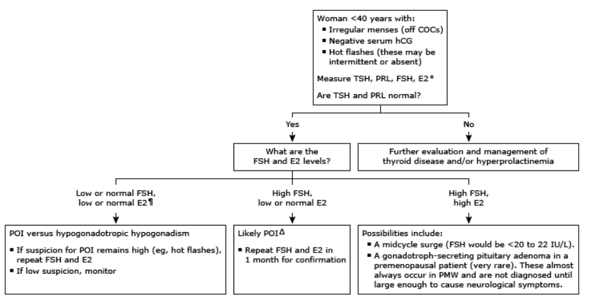

Slide 10
Physical features
Most women with 46,XX POI have experienced normal pubertal development and menarche
●Evidence of Hashimoto's thyroiditis or Graves' disease.
●Increased skin pigmentation or vitiligo related to autoimmune primary adrenal insufficiency. In this case, orthostatic hypotension may also be present.
●Signs of atrophic vaginitis may be seen
●Ovarian enlargement related to autoimmune lymphocytic oophoritis or a steroidogenic enzyme defect .This may also be noted on pelvic ultrasound.
●Ptosis, which has been associated with a rare familial form of POI (blepharophimosis/ptosis/epicanthus inversus syndrome [BPES])
●Features of Turner syndrome: short stature, low posterior hairline, high arched palate, shield chest with widely spaced nipples, a wide carrying angle, and short fourth and fifth metacarpals.

Slide 11
Biochemical features
low serum estradiol
elevated serum follicle-stimulating hormone (FSH)
if intermittent ovarian function: normal laboratory findings.
Transvaginal ultrasound
In 46,XX POI : Antral follicles that appear to be endocrinologically active in 75%.
Autoimmune oophoritis: large, luteinized follicle cysts; the characteristic appearance: enlarged cystic ovaries

Slide 12
Informing the patient of the diagnosis —
to inform the patient of the diagnosis in a sensitive and caring manner,
provide accurate information,
and offer referral to appropriate resources for emotional support.

Slide 13
EVALUATION TO EXCLUDE OTHER DISORDERS
pregnancy test
Serum prolactin concentration,
Thyroid-stimulating hormone (TSH)

Slide 14
ADDITIONAL EVALUATION ONCE DIAGNOSIS IS MADE
to determine the underlying cause of the POI and to evaluate for the presence of coexisting disorders.
The underlying cause has been considered to be unknown or "idiopathic" in up to 70 percent of women with POI.
However, whole exome or whole genome sequencing studies have identified the cause of POI in approximately 30 to 35 percent of patients.

Slide 15
Clues to underlying etiology
●Prior ovarian surgery, chemotherapy, or radiation therapy, as these all may damage ovarian tissue.
●Symptoms of anorexia, weight loss, vague abdominal pain, weakness, fatigue, salt craving, or increased skin pigmentation that suggest the presence of primary adrenal insufficiency. 3%. 300-fold increase compared with the general population.
●A personal or family history of autoimmune diseases, either alone or in combination, that might suggest polyglandular autoimmune syndromes, such as hypothyroidism or Graves' disease, primary adrenal insufficiency, vitiligo, myasthenia gravis, hypoparathyroidism, recurrent mucocutaneous candidiasis, or type 1 diabetes. Celiac disease should also be considered. Autoimmune oophoritis may occur as part of type I or type II syndromes of polyglandular autoimmune syndrome.
●A family history of POI, because approximately 10 percent of cases are familial. A family history of POI raises concern for a fragile X premutation.
●A family history of fragile X syndrome, intellectual disability, developmental delay, Parkinsonism, intension tremor, ataxia, or dementia, because approximately 6 percent of cases of POI are associated with premutations in the fragile X messenger ribonucleoprotein 1 (FMR1) gene (the gene responsible for the fragile X syndrome and the fragile X-associated tremor/ataxia syndrome).
●Association with deafness, because familial autosomal recessive POI may be associated with deafness as part of Perrault syndrome (autosomal recessive disease that is characterized by sensorineural hearing loss and ovarian dysgenesis in females).

Slide 16
Test for adrenal autoantibodies
Young women with POI are at increased risk for developing autoimmune adrenal insufficiency, a potentially fatal disorder.
Generally, POI precedes the development of symptomatic adrenal insufficiency by several years. 3 percent of women with POI will be found to have asymptomatic autoimmune adrenal insufficiency.
As a screen for the presence of asymptomatic autoimmune adrenal insufficiency, serum adrenal cortical and 21-hydroxylase antibodies should be measured in all women at the time of diagnosis of 46,XX POI.
Women with adrenal autoimmunity detected by the presence of autoantibodies have a 50 percent risk of developing adrenal insufficiency. These women should then be evaluated for the presence of adrenal insufficiency by an 8 AM serum cortisol and plasma corticotropin (ACTH).
Even if adrenal function is found to be normal at initial evaluation, women with positive adrenal cortical antibodies should be followed annually by these tests.

Slide 17
Other autoimmune evaluation
Young women with POI are also at increased risk of autoimmune hypothyroidism and should be screened for this condition.
Testing should therefore include thyroid-stimulating hormone (TSH) and thyroid-peroxidase autoantibodies.

Slide 18
Polyglandular Autoimmune syndrome(APS)
Autoimmune polyglandular syndrome type 1 is characterized by a triad of disorders chronic mucocutaneous candidiasis, hypoparathyroidism, and adrenal insufficiency. It is due to mutations in the AIRE (Autoimmune Regulator) gene and inherited in an autosomal recessive manner, clinically apparent by 15 YO.
Polyglandular autoimmune syndrome type 2 (PAS-2): polygenic inheritance. It is also called Schmidt syndrome and Carpenter syndrome. adrenal insufficiency, thyroid dysfunction, and diabetes mellitus type 1. clinically apparent by adulthood.

Slide 19
Karyotype
A karyotype should be performed as part of the basic evaluation for all patients with POI, with or without stigmata of Turner syndrome. Neither age of onset nor prior parity rules out a chromosomal abnormality. Overall, in patients who have experienced normal puberty before developing POI, an abnormal karyotype will explain the disorder in a low percentage of cases.
Women with X chromosome abnormalities have developed POI after having previously delivered normal children.
Women with Turner syndrome should be screened for associated abnormalities.
Although rare in women with POI, those with Y chromosome material present require oophorectomy because of the risk of gonadal tumors in women with Y chromosome-containing gonadal tissue. Molecular genetic techniques to identify the critical Y chromosome components have been developed

Slide 20
Assess bone mineral density with DXA
POI is an important risk factor for bone loss and osteoporosis.
at the time of diagnosis, a bone density test (dual-energy x-ray absorptiometry [DXA]) should be obtained.
Women with POI have a higher incidence of osteoporotic fractures, largely because of estrogen deficiency.

Slide 21
POI
Epidemiology
Diagnosis
Endocrine disorders and POI
Environmental factors
Rheumatologic and Immunologic disorders and POI
Genetic disorders and POI
Medical management of POI
PRP and POI
Stem cell therapy and POI

Slide 22
Environmental factors that might cause POI.
Air, water, soil, radiation, toxins, RF waves, laptop, microwave, oxidative stress, Bisphenol, PVC.

Slide 23
Genetics and POI
32yo lady with POI and Short statue, hearing difficulty, phototoxicity, learning disability, recurrent infection. What tests are recommended?
Turner
FXR mutations
Syndromic disorders

Slide 24
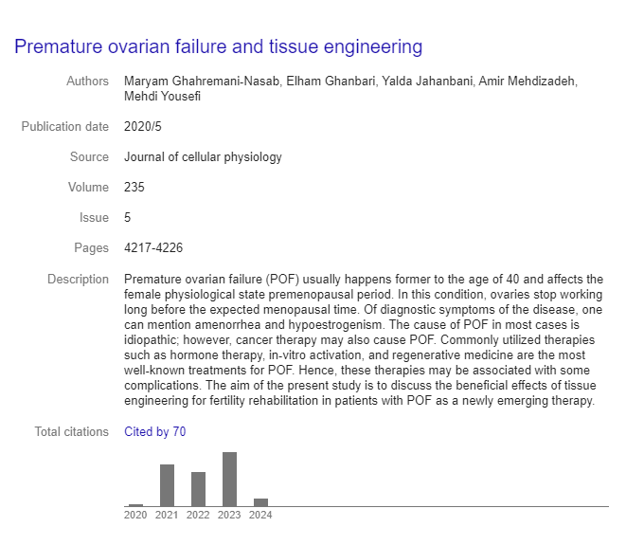
Immunology and POI
Mechanism

Slide 25
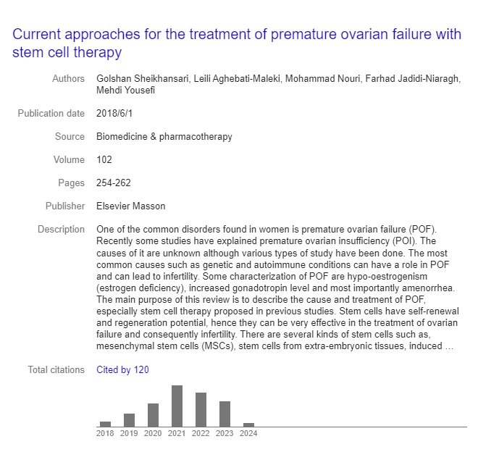

Slide 26
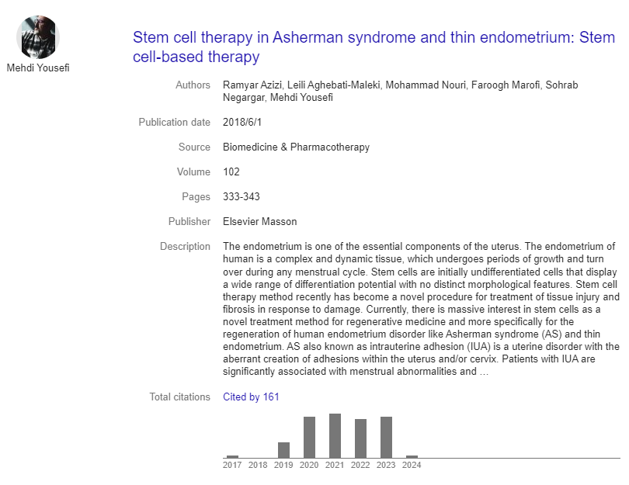

Slide 27
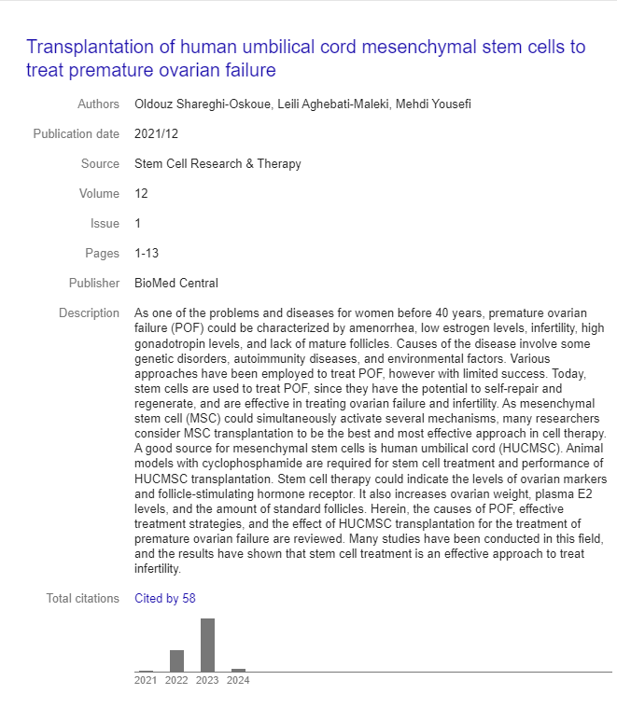

Slide 28
POI and Immunologic / Rheumatologic association
Diagnosis?
Prevention?
… ?

Slide 29
Medical therapy in POI
Choice?
Duration?
Contraception?
Fertility?
Oocyte freezing?

Slide 30
Stem cell therapy and POI
Which stem cells might be used BM, hair follicles, umbilical cord blood, fat, menstrual fluid?
How to use?
Efficacy and outcome?

Slide 31
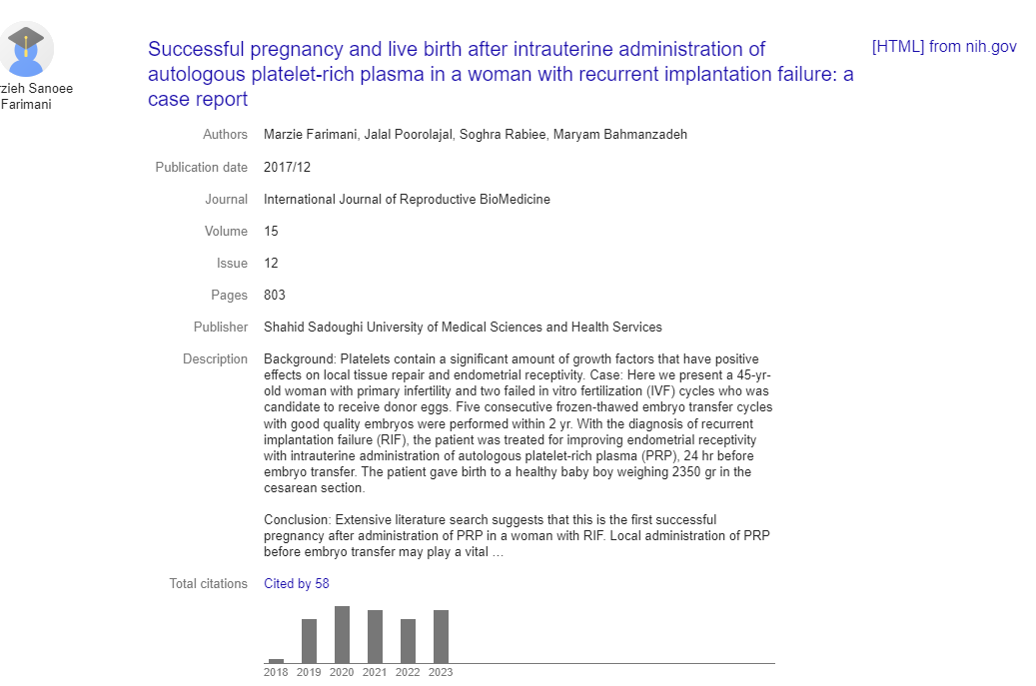

Slide 33
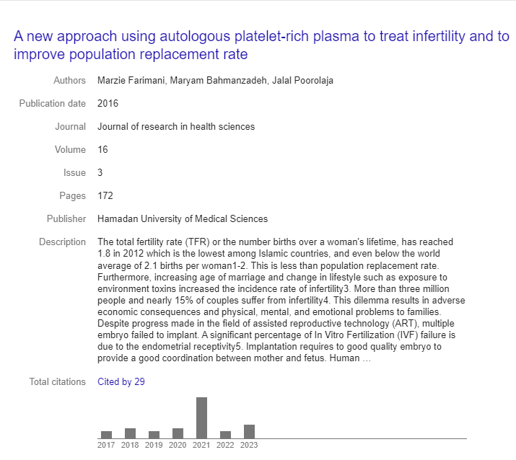

Slide 34
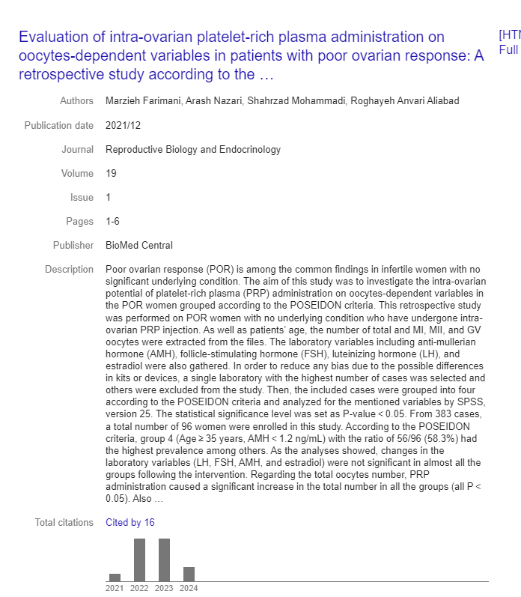

Slide 35
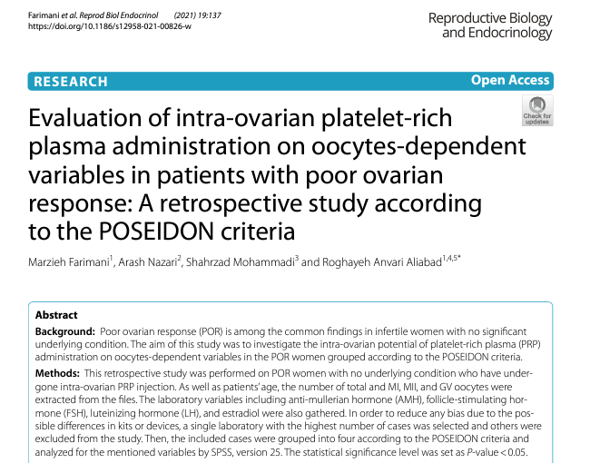

Slide 36
POSEIDON criteria:
Group 1: Age < 35 years, AMH ≥ 1.2 ng/ mL;
Group 2: Age ≥ 35 years, AMH ≥ 1.2 ng/mL;
Group 3: Age < 35 years, AMH < 1.2 ng/mL;
Group 4: Age ≥ 35 years, AMH < 1.2 ng/mL.

Slide 37
Administration of platelet rich plasma in the management of POI
In the ovary, uterus, cervix, muscle?
How it affects the AMH, Estrogen, AFC?
What is the mechanism?

